Slide 1






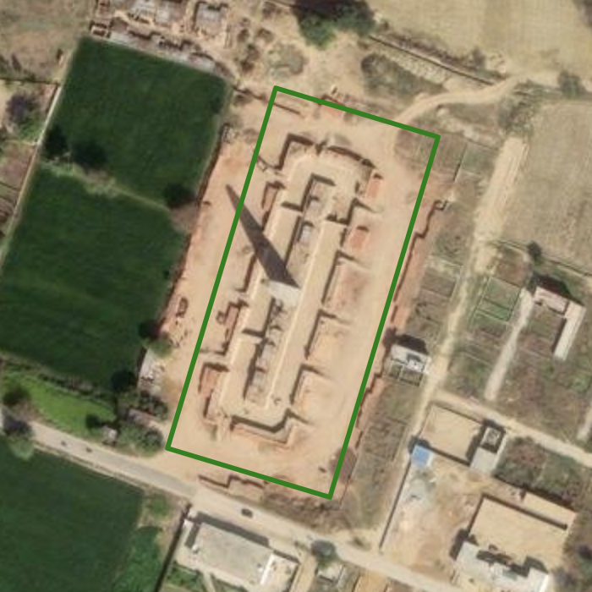
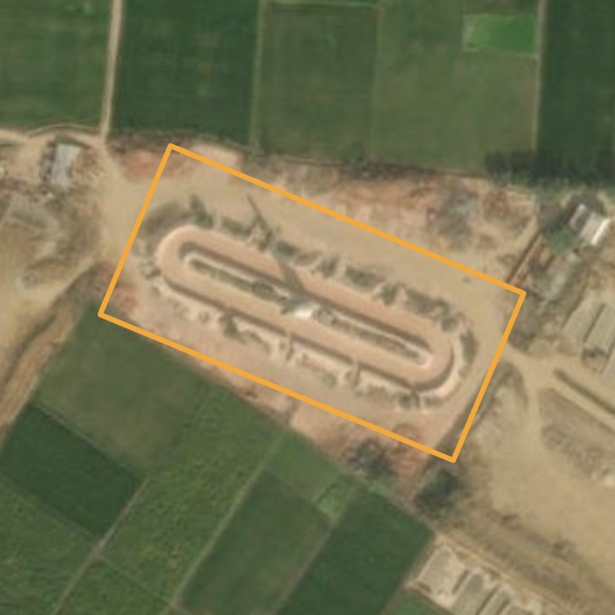
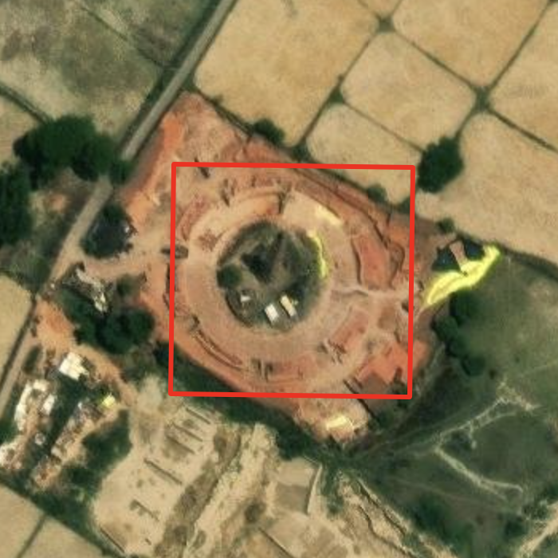
Advancing Brick Kiln Detection in Satellite Imagery using Modern Object Detection Techniques
Shardul Junagade, Rishabh Mondal, Prof. Nipun Batra
IIT Gandhinagar
Introduction
Air pollution accounts for ~8.1 million premature deaths annually.
Brick kilns contribute 8–14% of pollution in the Indo-Gangetic Plain.
Their scattered, unorganized nature makes large-scale detection crucial for research and planning.
This study leverages modern object detection techniques to enhance brick kiln detection from overhead imagery.
Brick Kiln Detection
Object Detection Models:
Experiments:
Evaluation:
Domain Adaptation:
Trained on Haryana dataset and tested on the Test Bihar dataset.
Super-Resolution
SwinIR: Swin Transformer-based image super-resolution model
Thera: An aliasing-free arbitrary-scale super-resolution method using neural heat fields
Conclusion
RHINO, a modern object detection model, significantly outperforms YOLO for brick kiln detection.
Super-resolution techniques, like SwinIR and Thera, further boost detection accuracy by improving image quality.
Models show some generalization across regions, with a slight performance drop.
Overall, combining advanced detection methods with image super-resolution techniques offers a scalable and accurate approach to monitor brick kilns.
References
YOLOv11m-obb RF-DETR RHINO
Converted annotations to model-specific formats.
Trained all models on Bihar region dataset
Tested on Test Bihar Dataset.
Objective
Detection and classification of brick kilns.
Improve detection accuracy using:
Applied Non-Maximum Suppression (NMS) with IoU threshold of 0.33.
Computed mAP@50 (mean Average Precision at IoU threshold 0.5) scores using supervision.
Comparison between Original (640) and Super-Resolved Images (2560)
Model | Super Resolution | Bihar to Bihar | Haryana to Bihar
YOLOv11m-obb | SwinIR | 57.50 | 46.00
 | Thera | 61.47 | 49.60
RFDETR Base | SwinIR | 52.95 | 38.00
 | Thera | 53.05 | 33.38
RFDETR Large | SwinIR | 55.10 | 43.33
 | Thera | 54.80 | 40.80
RHINO (Resnet50 Backbone) | SwinIR | 75.32 | 50.30
RHINO (SwinT Backbone) | SwinIR | 77.78 | 55.30
 | Thera | 76.73 | 61.03
SOTA object detection models
Advanced super-resolution techniques
Dataset
3 types of brick kilns: Zigzag, FCBK, CFCBK
Model | Bihar to Bihar | Haryana to Bihar
YOLOv11m-obb | 57.00 | 45.00
RFDETR Base | 49.76 | 36.78
RFDETR Large | 52.07 | 44.54
RHINO (Resnet50 Backbone) | 68.80 | 52.60
RHINO (SwinT Backbone) | 65.10 | 57.58
Region | Images | Zigzag | FCBK | CFCBK
Bihar | 641 | 1000 | 120 | 10
Haryana | 586 | 1000 | 120 | 10
Test Bihar | 687 | 1000 | 120 | 10
Zig-Zag
FCBK
CFCBK
[1] H. Lee, M. Song, J. Koo, and J. Seo, “Hausdorff Distance Matching with Adaptive Query Denoising for Rotated Detection Transformer,” arXiv.org, 2023. https://arxiv.org/abs/2305.07598
[2] J. Liang, J. Cao, G. Sun, K. Zhang, L. Van Gool, and R. Timofte, “SwinIR: Image Restoration Using Swin Transformer,” arXiv.org, Aug. 23, 2021. https://arxiv.org/abs/2108.10257
[3] A. Becker et al., “Thera: Aliasing-Free Arbitrary-Scale Super-Resolution with Neural Heat Fields,” arXiv.org, 2023. https://arxiv.org/abs/2311.17643
Image Size: 640 x 640
Rhino (SwinT Backbone) Detection Results
Same vs Cross-Region Training

